Slide 1
ASP.NET
Prepared By
Dulari Bhatt

Slide 2
Outline
Introduction to ASP.NET
Working with Web and HTML Controls
Using Rich Server Controls
Login controls
Overview of ASP.NETValidation Controls
Using the Simple Validations
Using the Complex Validators Accessing Data using ADO.NET
Using the Complex Validators Accessing Data using ADO.NET
Configuration Overview

Slide 3
Introduction to ASP.NET
ASP.NET is a web development platform, which provides a programming model, a comprehensive software infrastructure and various services required to build up robust web applications for PC, as well as mobile devices.
works on top of the HTTP protocol, and uses the HTTP commands and policies to set a browser-to-server bilateral communication and cooperation.

Slide 4
ASP.NET is a part of Microsoft .Net platform.
ASP.NET applications are compiled codes, written using the extensible and reusable components or objects present in .Net framework. These codes can use the entire hierarchy of classes in .Net framework.
codes can be written in :
C#
Visual Basic.Net
Jscript
J#
used to produce interactive, data-driven web applications over the internet.
It consists of a large number of controls such as text boxes, buttons, and labels for assembling, configuring, and manipulating code to create HTML pages.

Slide 5
Working with Web and HTML Controls
What is control?
Controls are small building blocks of the GUI, which include text boxes, buttons, check boxes, list boxes, labels, and numerous other tools. Using these tools, the users can enter data, make selections and indicate their preferences.
also used for structural jobs, like validation, data access, security, creating master pages, and data manipulation.

Slide 6
Web Control in ASP.net
There are 5 types of web control as listed below
HTML controls
HTML Server controls
ASP.NET Server controls
ASP.NET Ajax Server controls
User controls and custom controls

Slide 7
1. HTML controls
The original controls available to any HTML page.
These all work in ASP.NET exactly as they work in other web pages.

Slide 8
2. HTML Server controls
HTML server controls and ASP controls both offer significant improvements over the old-style HTML controls. These include:
The ability to automatically maintain state
Browser independence.
ASP.NET detects the level of the target browser. Up-level DHTML browsers are sent script for client-side processing. On down level standard browsers, all processing is done on the server. The appropriate HTML is generated for each browser.
Use of a compiled language instead of interpreted script, resulting in better performance.

Slide 9
Normal HTML controls such as <h1>, <a>, and <input> are not processed by the server, but are sent directly to the browser for display.
Standard HTML controls can be exposed to the server and made available for server-side processing by turning them into HTML server controls.
Server-side processing allows for data binding, programmatic response to events, and the ability to use a fully featured and compiled coding language rather than a scripting language.
In order to convert an HTML control to an HTML server control, simply add the attribute runat="server".
You can add an id attribute, so that contents of the control can be accessed and controlled programmatically.

Slide 10
<input type="text" size="40">
you can convert it to an HTML server control by adding the id and run at attributes, as follows:
<input type="text" id="BookTitle" size="40“ runat="server">
There are several benefits to converting an HTML control to an HTML server control:
Once a control is converted to a server control, it can be referred to in code.
Server controls retain state during round trips to the server Server controls generate events, which your code can then handle.
Server controls are aware of the client browser level and generate HTML appropriate to the target browser.

Slide 11
3. ASP.NET Server controls
These controls can be grouped into the following categories:
Validation controls - These are used to validate user input and they work by running client-side script.
Data source controls - These controls provides data binding to different data sources.
Data view controls - These are various lists and tables, which can bind to data from data sources for displaying.
Personalization controls - These are used for personalization of a page according to the user preferences, based on user information.

Slide 12
Login and security controls - These controls provide user authentication.
Master pages - These controls provide consistent layout and interface throughout the application.
Navigation controls - These controls help in navigation. For example, menus, tree view etc.
Rich controls - These controls implement special features. For example, AdRotator, FileUpload, and Calendar control.

Slide 13
The syntax for using server controls is:
<asp:controlType ID ="ControlID" runat="server" Property1=value1 [Property2=value2] />
In addition, visual studio has the following features, to help produce in error-free coding:
Dragging and dropping of controls in design view
IntelliSense feature that displays and auto-completes the properties
The properties window to set the property values directly

Slide 14
Properties of the Server Controls
ASP.NET server controls with a visual aspect are derived from the WebControl class and inherit all the properties, events, and methods of this class.
The WebControl class itself and some other server controls that are not visually rendered are derived from the System.Web.UI.Control class. For example, PlaceHolder control or XML control.
ASP.Net server controls inherit all properties, events, and methods of the WebControl and System.Web.UI.Control class.

Slide 15
Table shows the inherited properties, common to all server controls:
Property | Description
AccessKey | Pressing this key with the Alt key moves focus to the control.
Attributes | It is the collection of arbitrary attributes (for rendering only) that do not correspond to properties on the control.
BackColor | Background color.
BindingContainer | The control that contains this control's data binding
BorderColor | BorderColor
BorderStyle | BorderStyle
BorderWidth | BorderWidth
CausesValidation | Indicates if it causes validation
ChildControlCreated | It indicates whether the server control's child controls have been created.
ClientID | Control ID for HTML markup.

Slide 16
Property | Description
Context | The HttpContext object associated with the server control.
Controls | Collection of all controls contained within the control
ControlStyle | The style of the Web server control.
CssClass | CSS class
DataItemContainer | Gets a reference to the naming container if the naming container implements IDataItemContainer.
DataKeysContainer | Gets a reference to the naming container if the naming container implements IDataKeysControl.
DesignMode | It indicates whether the control is being used on a design surface.
DisabledCssClass | Gets or sets the CSS class to apply to the rendered HTML element when the control is disabled.
Enabled | Indicates whether the control is grayed out.
EnableTheming | Indicates whether theming applies to the control.
EnableViewState | Indicates whether the view state of the control is maintained.
Events | Gets a list of event handler delegates for the control.

Slide 17
Property | Description
Font | Font
Forecolor | Foreground color
HasAttributes | Indicates whether the control has attributes set.
HasChildViewState | Indicates whether the current server control's child controls have any saved view-state settings.
Height | Height in pixels or %.
ID | Identifier for the control.
IsChildControlStateCleared | Indicates whether controls contained within this control have control state.
IsEnabled | Gets a value indicating whether the control is enabled.
IsTrackingViewState | It indicates whether the server control is saving changes to its view state.
IsViewStateEnabled | It indicates whether view state is enabled for this control.
LoadViewStateById | It indicates whether the control participates in loading its view state by ID instead of index.
Page | Page containing the control.

Slide 18
Property | Description
Parent | Parent Control
RenderingCompatibility | It specifies the ASP.NET version that the rendered HTML will be compatible with.
Site | The container that hosts the current control when rendered on a design surface.
SkinID | Gets or sets the skin to apply to the control.
Style | Gets a collection of text attributes that will be rendered as a style attribute on the outer tag of the Web server control.
TabIndex | Gets or sets the tab index of the Web server control.
TagKey | Gets the HtmlTextWriterTag value that corresponds to this Web server control.
TagName | Gets the name of the control tag.
TemplateControl | The template that contains this control.
TemplateSourceDirectory | Gets the virtual directory of the page or control containing this control.
ToolTip | Gets or sets the text displayed when the mouse pointer hovers over the web server control.

Slide 19
Property | Description
UniqueID | Unique identifier.
ViewState | Gets a dictionary of state information that saves and restores the view state of a server control across multiple requests for the same page.
ViewStateIgnoreCase | It indicates whether the StateBag object is case-insensitive.
ViewStateMode | Gets or sets the view-state mode of this control.
Visible | It indicates whether a server control is visible.
Width | Gets or sets the width of the Web server control.

Slide 20
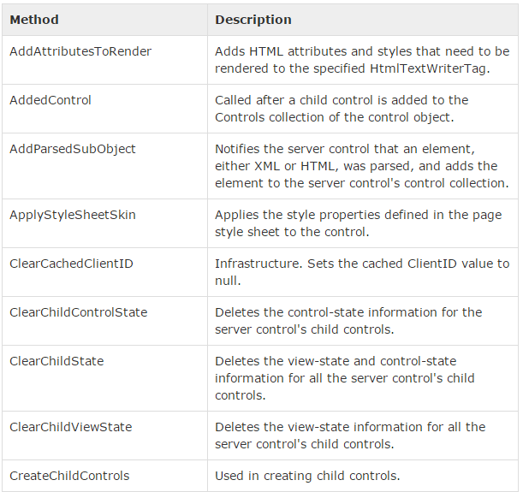
Methods of the Server Controls

Slide 21
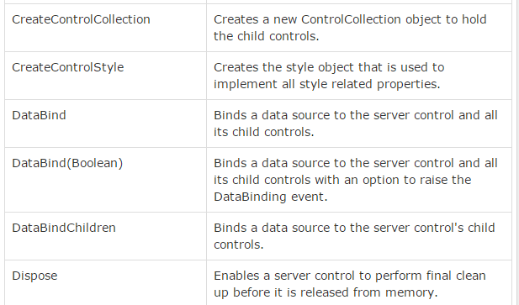

Slide 22
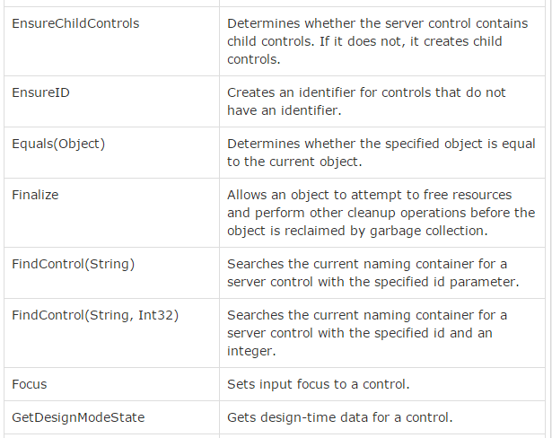

Slide 23
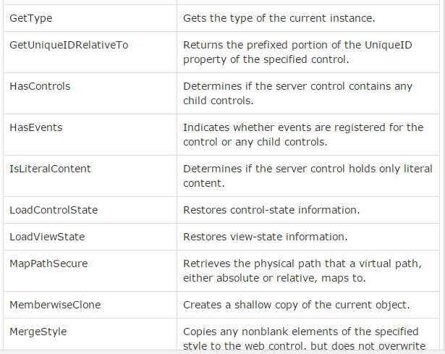

Slide 24
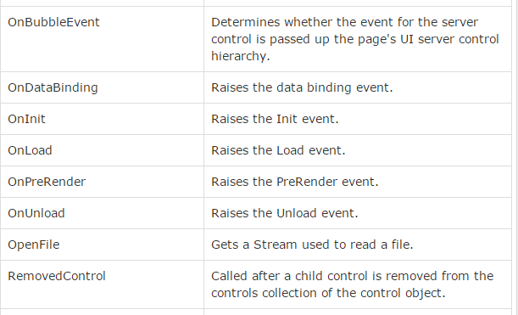

Slide 25
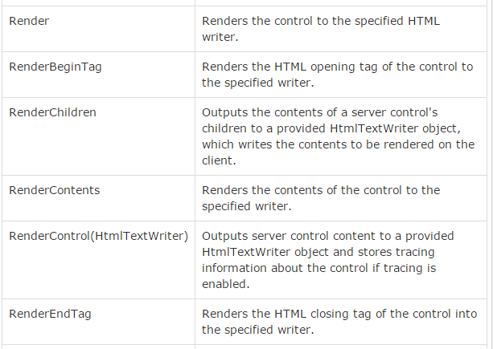

Slide 26
